Slide 1
Unit 3: Systems
Advanced

Slide 2
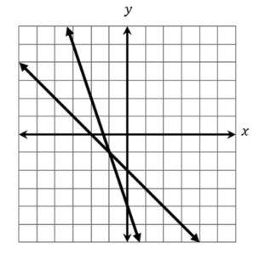

9/23 SAT Bell Work
What coordinate represents the solution to the system of equations below?
Notes:
x

Slide 3
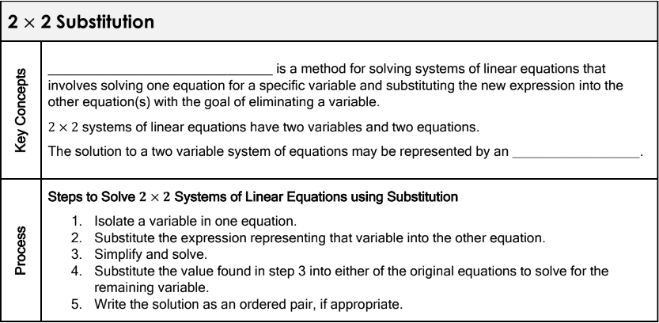
3.1: 2 Linear Equations with 2 Variables
Learning Objective: I will be able to solve 2 linear equations with 2 variables.

Slide 4
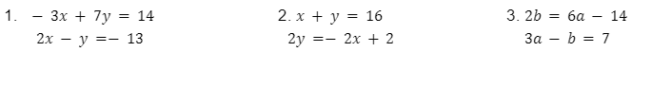
3.1: 2 Linear Equations with 2 Variables
Learning Objective: I will be able to solve 2 linear equations with 2 variables.

Slide 5
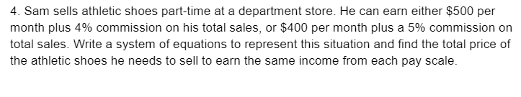
3.1: 2 Linear Equations with 2 Variables
Learning Objective: I will be able to solve 2 linear equations with 2 variables.

Slide 6
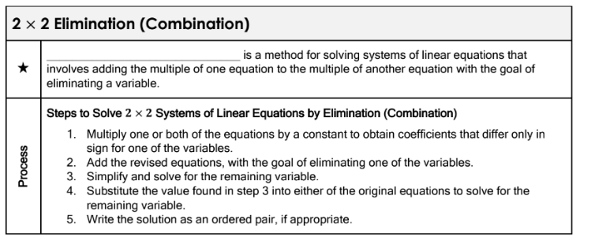
3.1: 2 Linear Equations with 2 Variables
Learning Objective: I will be able to solve 2 linear equations with 2 variables.

Slide 7
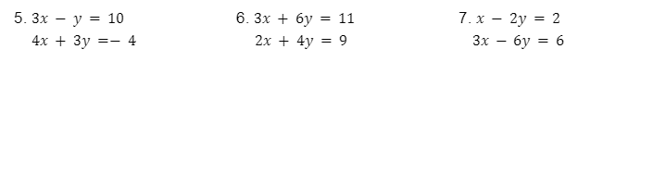
3.1: 2 Linear Equations with 2 Variables
Learning Objective: I will be able to solve 2 linear equations with 2 variables.

Slide 8
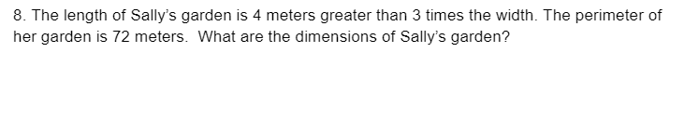
3.1: 2 Linear Equations with 2 Variables
Learning Objective: I will be able to solve 2 linear equations with 2 variables.

Slide 9
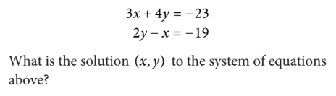

9/24 SAT Bell Work
Notes:
x

Slide 10
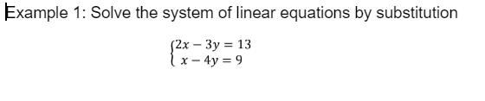
3.2: Solving By Substitution
Learning Objective: I will be able to solve 3 linear equations with 3 variables by substitution.

Slide 11
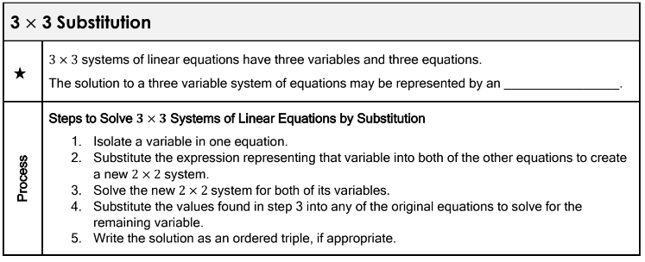
3.2: Solving By Substitution
Learning Objective: I will be able to solve 3 linear equations with 3 variables by substitution.

Slide 12
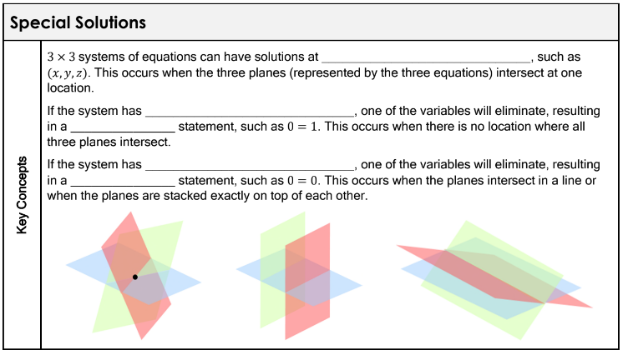
3.2: Solving By Substitution
Learning Objective: I will be able to solve 3 linear equations with 3 variables by substitution.

Slide 13
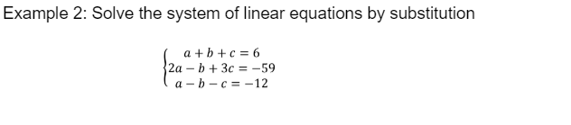
3.2: Solving By Substitution
Learning Objective: I will be able to solve 3 linear equations with 3 variables by substitution.

Slide 14
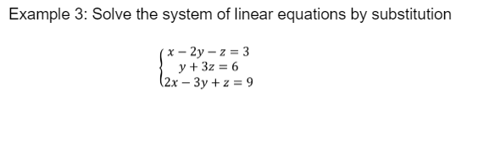
3.2: Solving By Substitution
Learning Objective: I will be able to solve 3 linear equations with 3 variables by substitution.

Slide 15
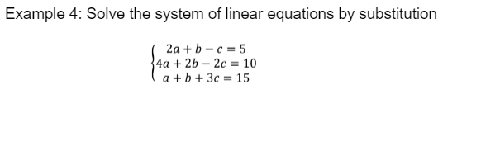
3.2: Solving By Substitution
Learning Objective: I will be able to solve 3 linear equations with 3 variables by substitution.

Slide 16
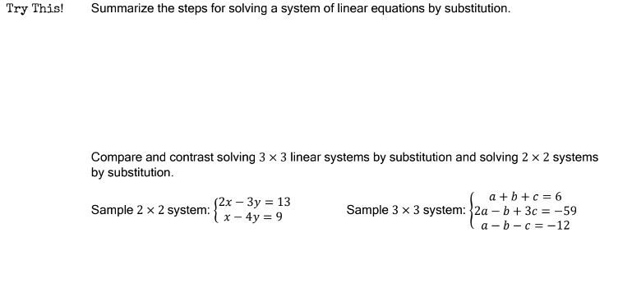
3.2: Solving By Substitution
Learning Objective: I will be able to solve 3 linear equations with 3 variables by substitution.

Slide 17
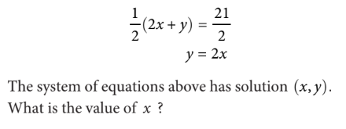

9/26 SAT Bell Work

Slide 18
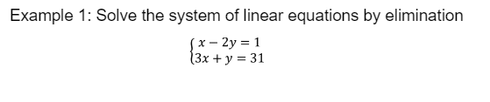
3.3: Solving By Elimination
Learning Objective: I will be able to solve 3 linear equations with 3 variables by elimination.

Slide 19
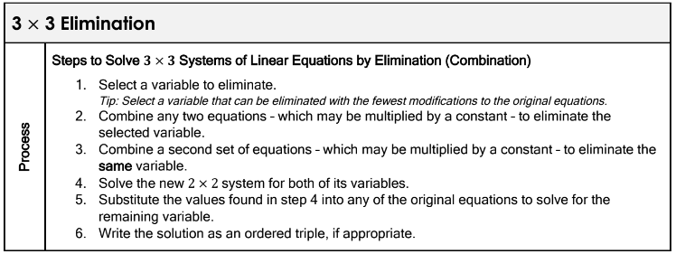
3.3: Solving By Elimination
Learning Objective: I will be able to solve 3 linear equations with 3 variables by elimination.

Slide 20
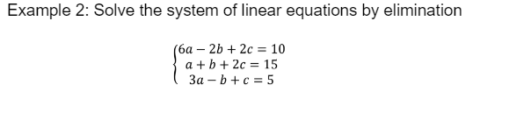
3.3: Solving By Elimination
Learning Objective: I will be able to solve 3 linear equations with 3 variables by elimination.

Slide 21
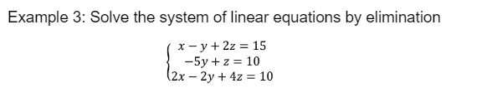
3.3: Solving By Elimination
Learning Objective: I will be able to solve 3 linear equations with 3 variables by elimination.

Slide 22
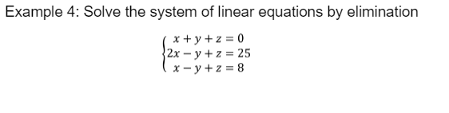
3.3: Solving By Elimination
Learning Objective: I will be able to solve 3 linear equations with 3 variables by elimination.

Slide 23
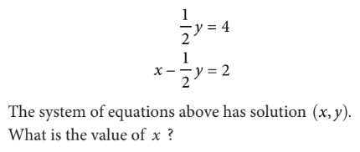

9/27 SAT Bell Work

Slide 24
Practice Day
Work on the mixed practice.
When you are finished work on IXL

Slide 25
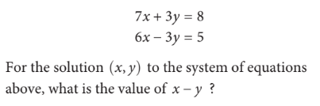


9/30 SAT Bell Work

Slide 26
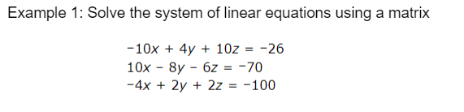
3.3: Solving By Matrix
Learning Objective: I will be able to solve 3 linear equations with 3 variables using matrices.

Slide 27
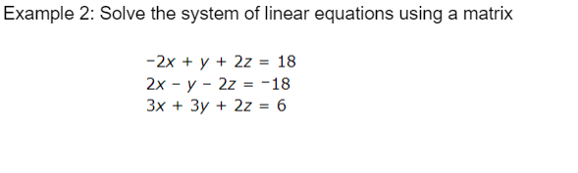
3.3: Solving By Matrix
Learning Objective: I will be able to solve 3 linear equations with 3 variables using matrices.

Slide 28
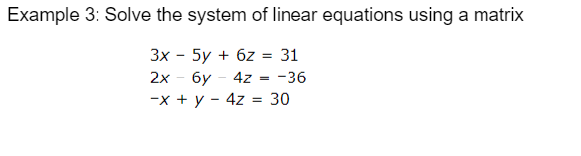
3.3: Solving By Matrix
Learning Objective: I will be able to solve 3 linear equations with 3 variables using matrices.

Slide 29
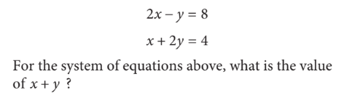

10/1 SAT Bell Work

Slide 30

3.4: Applications
Learning Objective: I will be able to solve 3 linear equations with 3 variables in real world situations.

Slide 31
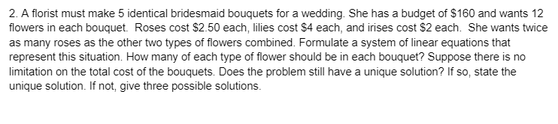
3.4: Applications
Learning Objective: I will be able to solve 3 linear equations with 3 variables in real world situations.

Slide 32
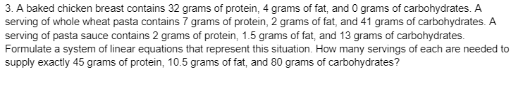
3.4: Applications
Learning Objective: I will be able to solve 3 linear equations with 3 variables in real world situations.

Slide 33

3.4: Applications
Learning Objective: I will be able to solve 3 linear equations with 3 variables in real world situations.

Slide 34
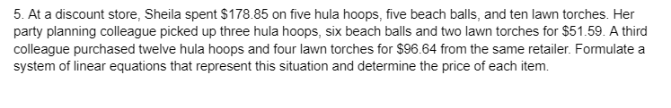
3.4: Applications
Learning Objective: I will be able to solve 3 linear equations with 3 variables in real world situations.

Slide 35
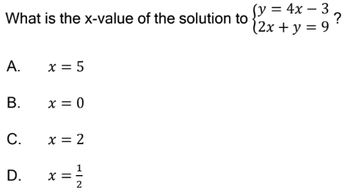

10/2 SAT Bell Work

Slide 36
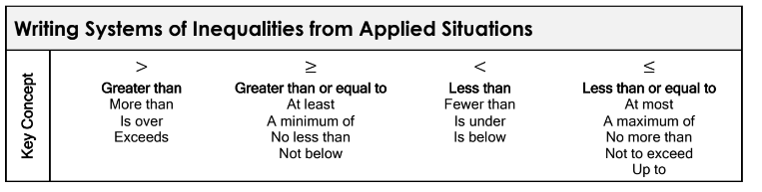
3.5: Inequalities
Learning Objective: I will be able to solve systems of linear inequalities.

Slide 37
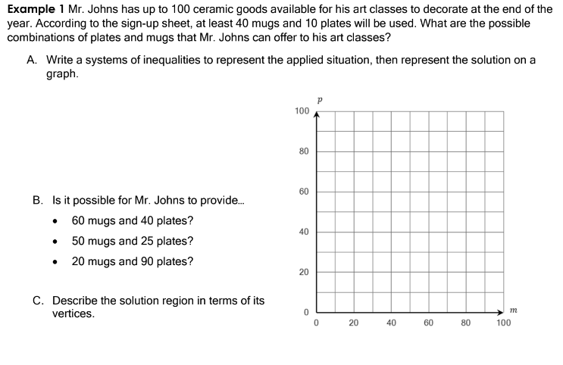
3.5: Inequalities
Learning Objective: I will be able to solve systems of linear inequalities.

Slide 38
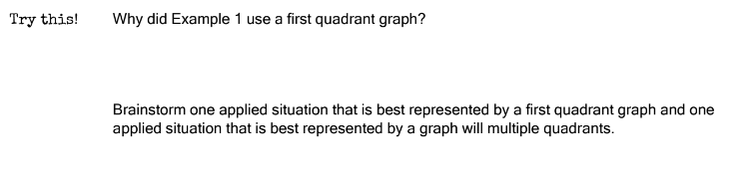
3.5: Inequalities
Learning Objective: I will be able to solve systems of linear inequalities.

Slide 39
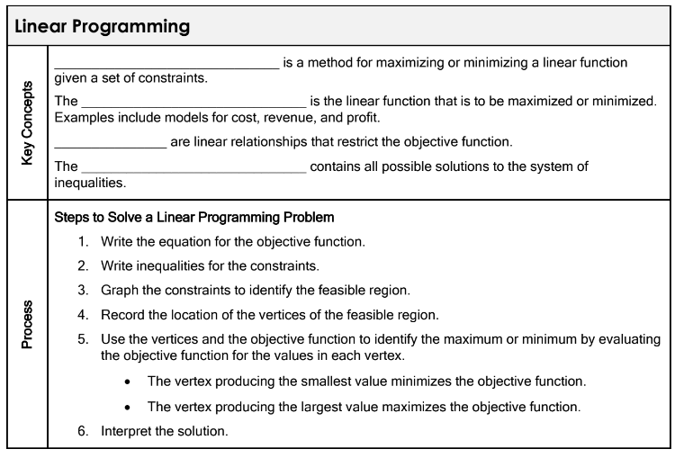
3.5: Inequalities
Learning Objective: I will be able to solve systems of linear inequalities.

Slide 40
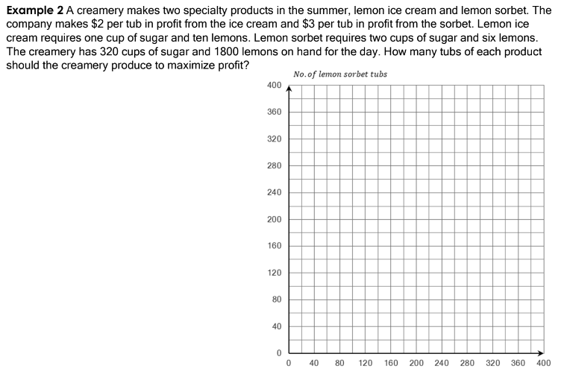
3.5: Inequalities
Learning Objective: I will be able to solve systems of linear inequalities.

Slide 41
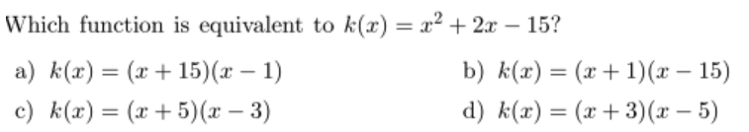
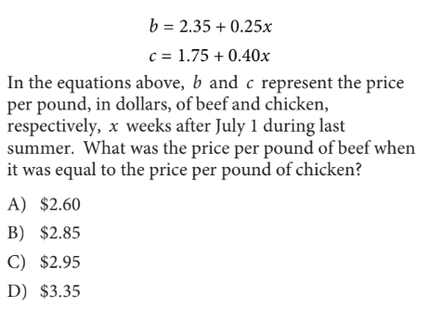
10/3 SAT Bell Work

